Slide 1
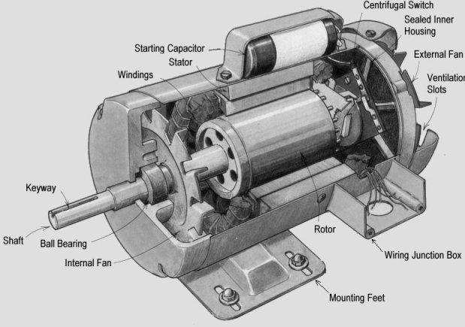
ELECTRIC MOTOR TEMPERATURE
PANTHERS GROUP

Slide 2
Business Objective
Predict Temperature based on other attributes available.
The dataset comprises several sensor data collected from a permanent magnet synchronous motor(PMSM) deployed on a test bench. The PMSM represents a German OEM’s prototype model. Test bench measurements were collected by the LEA department at Paderborn University.
All recordings are sampled at 2Hz. The dataset consists of multiple measurement sessions, which can be distinguished from each other by column ”profile id ”. A measurement session can be between one and six hours long. The motor is excited by hand-designed driving cycle denoting a reference motor speed and a reference torque. Current in d/q coordinate (columns “u d” and “u q” ) and voltage in d/q coordinate (columns “u d” and “u q”) are a result of standard control strategy trying to follow the reference speed and torque. Columns ”motor speed” and “torque” are the resulting quantities achieved by that strategy, derived from set currents and voltage.

Slide 3
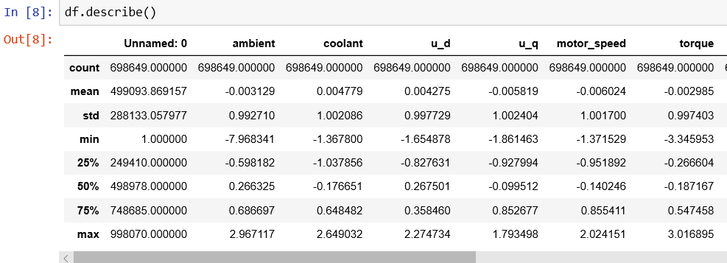
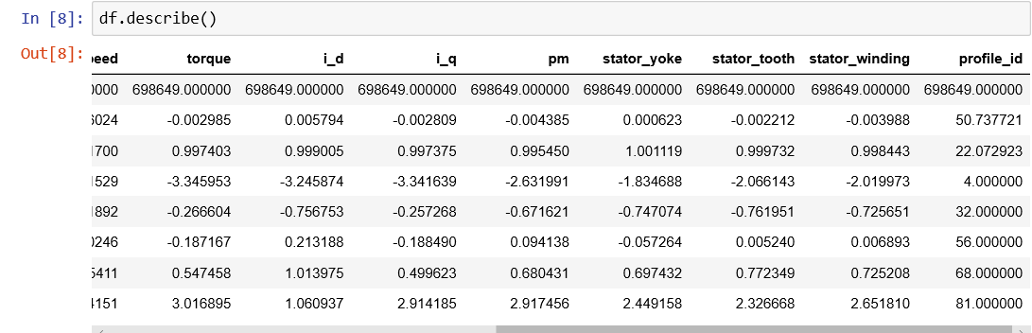
Dataset Details
13 columns and 698649 rows
No missing/null values
no duplicates
no categorical or alphanumeric or text features

Slide 4
EDA
Histograms
The Histogram of the ambient temp and i_d shows that the data left(negatively) skewed and the coolant is right(positively) skewed.
Torque and i_q seems to be leptokurtic distributions having positive kurtosis(Leptokurtic), indicates higher outliers.
pm(rotor temperature),stator tooth , stator winding, stator yoke are platykurtic distributions and have negative kurtosis(platykurtic), indicates the low outliers.
motor speed is positively skewed.
u_d ,u_q and profile_id are not normally distributed.

Slide 5
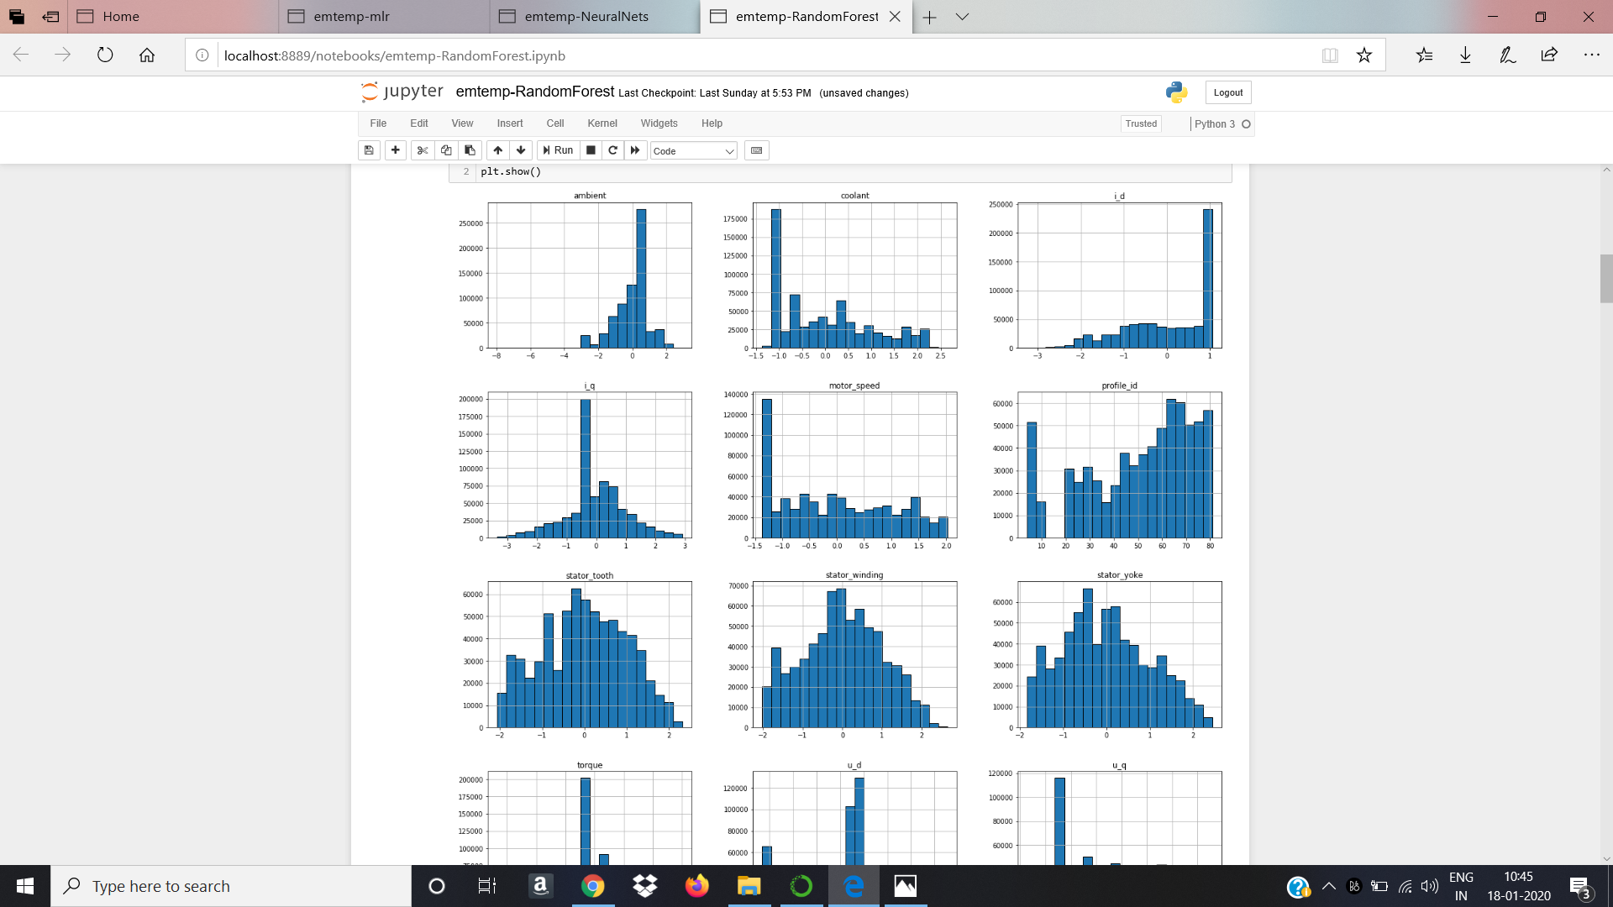

Slide 6
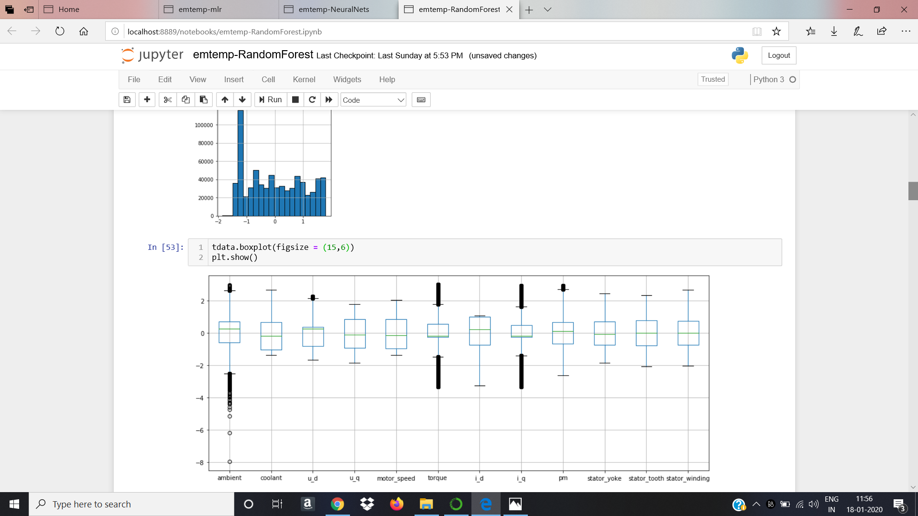
EDA
(Box Plots)
Boxplot of the ambient temp shows that the data is left skewed and have high outliers.
Boxplot of coolant,u_q,motor_speed,i_d, stator_yoke, stator_tooth, stator_winding indicates the absence of outliers in the respective data.
Boxplot of u_d, torque, i_q indicates the presence of outliers in the data.
As we have lots of outliers, we have treated them with IQR method.

Slide 7
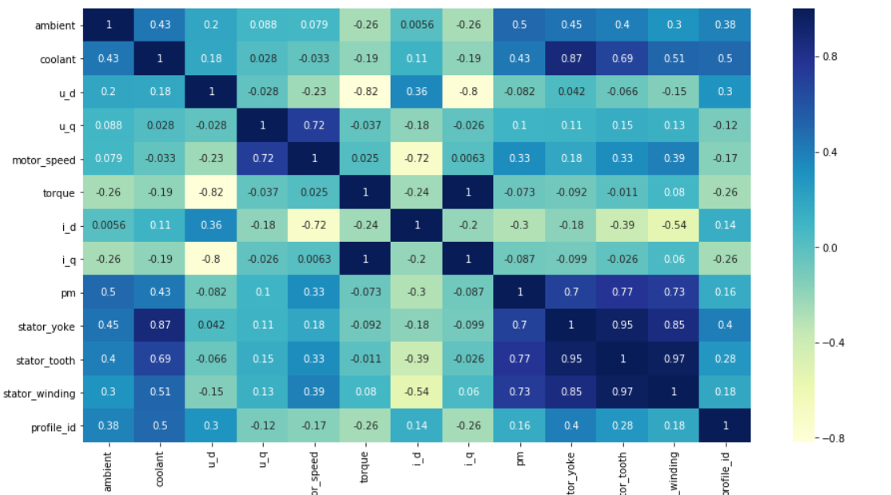
Correlation
1) stator_yoke and coolant are positively correlated.
2) i_q and torque are positively correlated.
3) stator_tooth and stator_winding are positively correlated.
4)stator winding and stator_yoke are positively correlated.
These highly correlated predictors may cause multicollinearity issue while building the model.

Slide 8
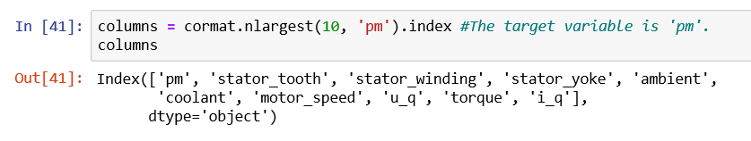
Feature Engineering
We took the top ten features.

Slide 9
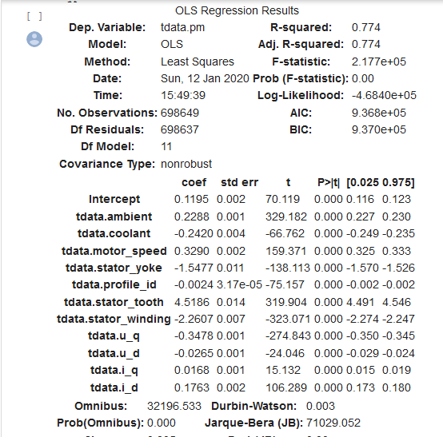
Model Prediction
Model- MLR(using OLS method)

Slide 10
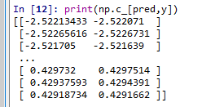
Model Building
MODEL- Random Forest
error- 0.001
accuracy- 99.9%
rmse value - 0.3235

Slide 11
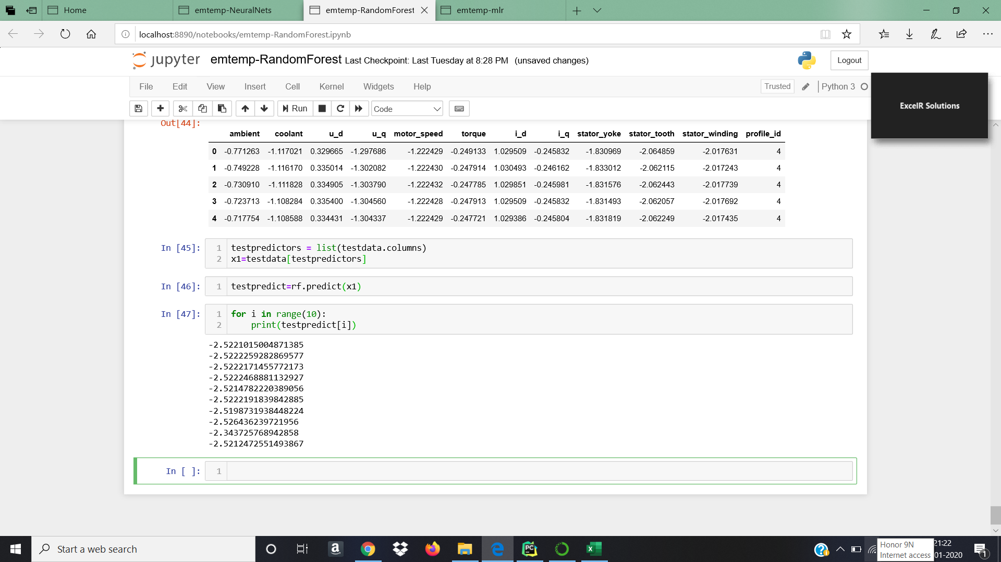

Slide 12

Model Deployment
The Model Deployed is Random Forest Regressor.
For deployment we have create two files like app.py and server.py
Using app.py file we have created model.pkl file.

Slide 13
Cont.
Flask File creation:
Second file named server.py in this we have import flask
Using @app.route(‘/’) url to execute homepage function which named as DOCTYPE.html
Using @app.route(‘/predict’, mothods=[‘post’]) transfer data to server and provide input
After that we have Predict using this link http://127.0.0.1:5000/

Slide 14
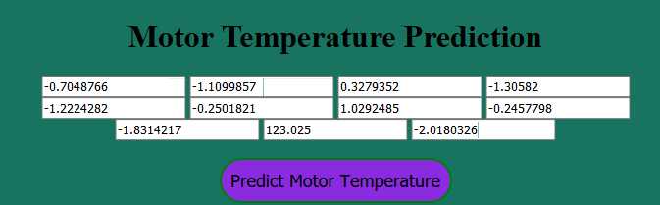
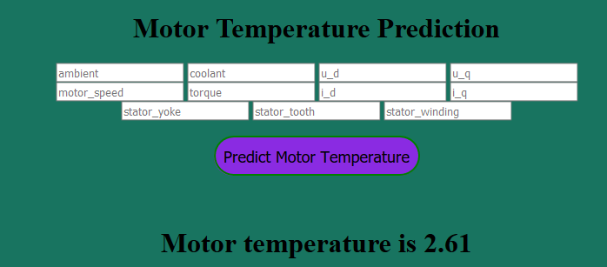
Cont.
Input Variables
Output: ------->>

Slide 15


